Slide 1
Town Manager FY2025 BUDGET PRESENTATION July 1, 2024-June 30, 2025
(Financial) State of the Town
SELECT BOARD
JANUARY 23, 2024
Jill Goldsmith, Town Manager
Carrie Mazerolle, Finance Director
Notes:
As we embark on the Fiscal Year 2025 budgetary journey, we are proud to present An All-Encompassing Budget to Chart Chatham’s Future designed to address current challenges and pave the way for lasting community investment. A successful budget review also involves evaluating programs, engaging the public, and setting goals to benefit all citizens. Despite ongoing hurdles like supply chain limitations, utility costs, and inflation, we continue to adapt our operations to ensure seamless service delivery. Using data - historical trends, conservative forecasts, and assumptions, the FY2025 budget adheres to a level-services approach reflecting a commitment to fiscal prudence while funding programs and services for the entire community.

Slide 2
Town’s Fiscal Position State of the Town
Overview of Town Manager’s FY2025 Budget Summary Transmittal
and
Digital Budget Book for FY2025
https://town-chatham-ma-budget-book.cleargov.com/13703
Notes:
UPDATE NOTES FOR FY2025 – Review Budget Message Transmittal components and turn it over to Carrie to review digital budget book sections.
Review the components of the Transmittal memo as a State of the Town – G&O, Value Statements; Reflection on FY2024/CY2023 – Community Connections/Initiatives; Economic Conditions Summary – Building Activity; FY2025 Budget Detail – Revenues and Expenditure explanations; Wage/Salary Overview; Education Budget details; Capital Program including Water – and status reports of the Wastewater Projects; Waterfront Infrastructure Projects; Renewable Energy; Climate Change/Coastal Resiliency Efforts; Technology/On-line offerings/ Emergency Management and generators – New Digital Budget Book for FY2024. Budgets should reflect priorities, therefore, the proposed FY2025 Operating and Capital Budgets provide for strategic budgeting of such and also redirects and enhances staffing resources to achieve the goal of a resilient and sustainable community for the future

Slide 3
State of the Town
Property values remain high
Tax rate remains low ($3.57)
AAA Bond Rating (affirmed May 25, 2023)
Reserves stable to FY2023
OPEB funding strategy
Budget and Financial Policies review
Budget Summits – Multi-year Forecasts
Notes:
No use of reserves (Stabilization Fund); Free Cash certified at acceptable rate (funds available to support capital items)
Reserves for General Fund are stable. Water fund declined due to using water surplus for capital last few years, will monitor.

Slide 4
FY2021-2024 & FY2025 Budgets
“Budgeting the Unknown”
“COVID Core Services Budget”
“Budgeting for a Resilient and Sustainable Future”
“Strategic Budgeting for the Future”
FY2025 "An All-Encompassing Budget to Chart Chatham's Future"
Notes:
Our FY2021 Level Services/Growth Budget pivoted dramatically to the COVID-19 Budgeting in the Unknown as the start of our COVID financial Planning.
FY2022 budget based on Core services as uncertainty remained.
FY2023 was a growth budget to respond to the workload and Select Board objectives.
FY2024 Level Services/Growth Budget maintained current level of services but with additional staffing.
FY2025 – is a level service, stabilizing growth budget as presented. As noted before, the budget directive reflects a commitment to fiscal prudence while funding programs and services to benefit the entire community.

Slide 5
Town’s Budgetary Components

Slide 6
Balanced Budget: Revenue = Expense
Revenue Outlook
Tax Levy, Local Receipts, Other Available Funds
Expenditures
General Operating Budget
Educational Assessments
Water Operating Budget
Five Year Capital Plan
Other Capital and Community Priority Items
Separate Articles for Consideration
Capital Priorities & Five -Year Capital Plan
Notes:
As mentioned at the Budget Summit in October every year we begin with the available sources of funds – revenue.
Expenses begin with the D.H. requesting funds to support a level service budget.

Slide 7
The FY2025 Budget
Digital Budget Book
Budget Narratives
Budget Statements
Prior Year Accomplishments
Organization Charts
Staffing History
FY2025 Capital Improvement Plan Requests & Inventory
Budget Central https://www.chatham-ma.gov/214/Budget-Central
Budget Book
Any Budget Updates
Multi-year Financial Forecasts and Policies
Fleet Listing
Debt Schedule
https://town-chatham-ma-budget-book.cleargov.com/13703
Notes:
JG

Slide 8
Navigating the FY2025 Digital Budget Book https://town-chatham-ma-budget-book.cleargov.com/13703
Notes:
SCROLL THROUGH THE BUDGET BOOK HERE?
For FY2025, we leveraged the cleargov digital budget book platform initiated in FY2024. This platform facilitates direct input of budget requests by Department/Division Heads, allowing real-time update through the budget review process. Our commitment to transparency extends to providing additional information in the budget books including demographic details, fund balances, organization charts, department personnel and expense expenditures, and prior year (2023) accomplishments. Visual presentations using charts/graphs enhance the accessibility of operating and capital budget recommendations. The platform auto-generates information required to meet the Government Finance Officers Association (GFOA) distinguished budget book award; a goal we hope to achieve before 2030. A GFOA distinguished Budget includes the above components that provide the public with understandable and transparent information.

Slide 9
I. FY2025 Balanced Budget
An All-Encompassing Budget to Chart Chatham's Future

Slide 10
FY2025 Budget Highlights
Sustainable Service Budget - Operating Budget, without education assessments, at $40,019,480 for an increase of $1,928,940 or 5.06% over FY2024. Funded with available revenues with no increase to the FY2024 Tax Rate of $3.57;
Funding recommendations include sustainable services and level staffing.
Capital Plan at $2,367,220 or 5.4% (within the range of 9% per Chatham’s Budget and Financial Management Policy) of the Operating Budget and funded through free cash and other available funds – no use of the tax levy.
Notes:
This fiscal year, our budget directive reflects a commitment to fiscal prudence while funding programs and services to benefit the entire community. The foundation of the approach is built upon best financial practices and strategic principles, encompassing a vision that spans 4-10 years, a strategic direction for 2 years, and tactical actions for the immediate future. Aligned with our commitment to priorities, the FY2025 Operating and Capital Budgets strategically allocate resources to achieve the objective of a resilient and sustainable community.
At this time, the budget is funded with no increase to the tax levy. This may change depending upon priorities (articles) brought forward to ATM

Slide 11
 |  |  | FY2024 Budget | FY2025 Estimate |  | $ Change |  | % Change
Revenues
 | Property Tax |  | $41,850,175 | $41,708,169 |  | ($142,006) |  | -0.34%
 | Local Receipts |  | $9,344,179 | $10,716,760 |  | $1,372,581 |  | 14.69%
 | State Aid |  | $247,123 | $241,136 |  | ($5,987) |  | -2.42%
 | Other Available Funds |  | $7,733,539 | $7,446,010 |  | ($287,529) |  | -3.72%
 | Water Fund |  | $4,063,572 | $3,999,250 |  | ($64,322) |  | -1.58%
 |  |  | $63,238,588 | $64,111,325 |  | $872,737 |  | 1.38%
Expenditures
 | Municipal Departments |  | $38,090,540 | $40,016,023 |  | $1,925,483 |  | 5.06%
 | School Department |  | $10,086,552 | $11,069,927 |  | $983,375 |  | 9.75%
 | Water Department (w/capital) |  | $4,463,572 | $4,399,250 |  | ($64,322) |  | -1.44%
 | Capital Budget |  | $3,674,000 | $2,367,220 |  | ($1,306,780) |  | -35.56%
 | Assessments |  | $1,134,602 | $1,329,348 |  | $194,746 |  | 17.16%
 | Other Articles [Placeholders] |  | $5,789,322 | $1,556,857 |  | ($4,983,143) |  | -76.19%
 |  |  | $63,238,588 | $60,738,625 |  | ($3,250,639) |  | -5.08%
Notes:
Tax Levy less due to greater Excess Levy Capacity (4.4m vs. 3.3 in FY2024)
Increasing local estimated receipts, 85% of Actuals received in FY23
Overall the budget without education has increased 5.06%
There is a proposed increase of 9.75% in education –which I will go over in another slide
We are estimating to receive $2.5 million in Free Cash to cover Capital Requests for FY2025, which is a decrease over the prior fiscal years.
Other Article Placeholders, this is just estimate as of right now and will need review by the selectboard in upcoming weeks.

Slide 12
Tax Levy | FY2025
Base (prior year limit) | 36,856,537
X 2.5% | 921,413
New Growth | 400,000
Debt Exclusions – prior approved debt | 7,213,461
MRSD debt exclusion – prior approved | 409,845
Barnstable County Tax | 337,948
Total Estimated Allowable Levy “Ceiling” | $46,113,169
Excess Levy Capacity – Not Used | (4,405,000)
Total Estimated Tax Levy | $41,708,169
Notes:
Tax Levy – Includes the Prior Year Base of $36,856,537, plus prop 2 ½% at $921,413, plus an estimated amount of new growth of $400,000, plus Prior approved debt exclusions at $7,213,461, plus prior approved MRSD Debt Exclusion at $409,845, plus estimated amount for Barnstable County Tax of $337,948 which equals our total estimated allowable levy Ceiling – . With this Budget we are presenting in 2025, we are estimating that there will be 4.4Million in excess levy capacity.

Slide 13
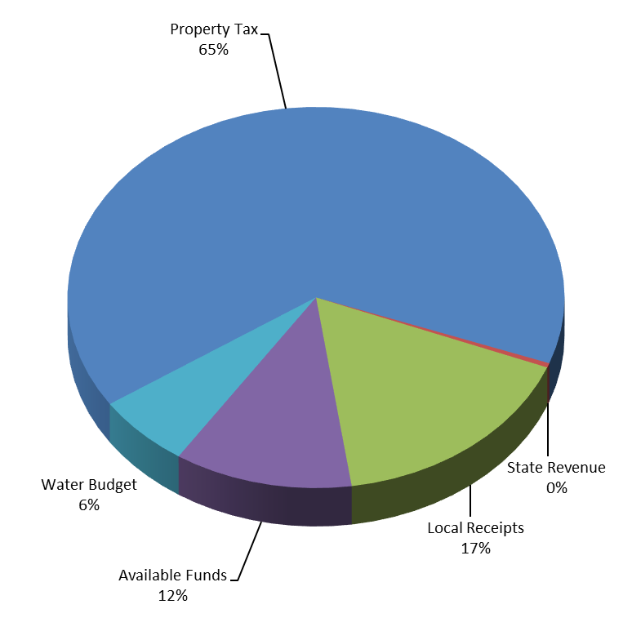
II. FY2025 REVENUES
Notes:
Our Revenues for our 2025 Budget Include
65% percent of our revenues are from Property Taxes, also known as the Tax Levy
17% of Local Receipts, which includes motor vehicle excise tax, hotel/motel revenues, meals tax revenues, departmental Fees.
12% of other Available Funds, which include not included in local receipts, such as Sale of Lots, Perpetual Care, Public Education Access Funds and water ways improvement.
State Revenue, we are estimating to receive ruffly $241,000 a slight increase. The governors budget will be out soon.
6% is the Water Budget.
Other available funds include free cash, overlay surplus, landbank etc.
Water Debt or other Debt/ Borrowing not in here.

Slide 14
Local Receipts
Notes:
Our Local receipts are estimated at 85% of the prior year actuals, as you can see in this graph our actual local receipts in 2022 and 2023 are exceeding the estimated receipts for 2024 and 2025. Our estimates are conservative.

Slide 15
Other Available Funds (Offsets) Receipts Reserved For Appropriation
Waterways Improvement Fund - $250,000
Harbormaster Capital & Operating budget(s)
Railroad Museum Fund (operating costs) - $5,000
PEG Access Funds - $150,000
Chatham TV Capital & Operating budget(s)
Sale of Lots & Graves Trust - $35,000
Wetlands Protection Fund - $55,000
Notes:
These are other funding sources, that help support the Operating Budget.
Offset to the Tax Rate. Future offset will be from the increase in rooms tax – for housing and/or CES

Slide 16
Other Available Funds (Offsets)
Revolving Funds
Recreation Revolving (program costs)
Shellfish Revolving (for propagation costs)
Chapter 90 (Highway) State Aid Fund
$347,000 estimate
Cape Cod & Islands Water Protection Fund - $615,160
Debt Service
Waterways User Fees (WUF) $1,819,095.32 - Bond Projects Offset
Notes:
Chapter 90 –about $347,000 per year.
ARPA – - $608,100 in local funds. electronic voting, other capital items. Barnstable County funds – wastewater?

Slide 17
FY2025 Revenue
Estimated Levy Limit $41,709,169
Allowed 2.5% increase - $921,413
“New Growth” - $400,000
Estimated Local Receipts $10,716,760
Approx. 85% of Prior Year (2023)Actual
Estimated Other Available Funds
Notes:
Programmed $4,405,000 of excess levy capacity.

Slide 18
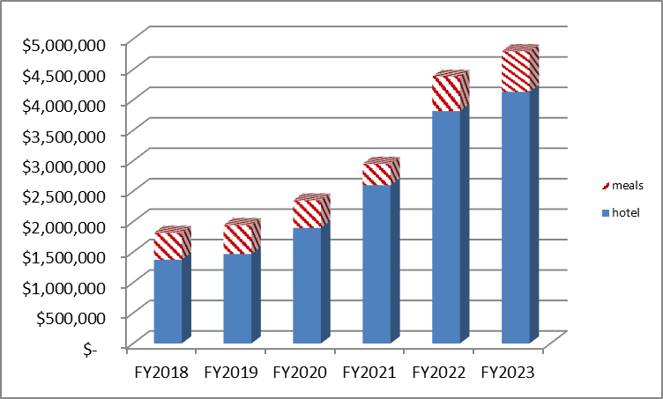
Traditional & S/T Rooms and Meals Tax Revenues
Notes:
This graph is showing the growth of the Town of Chatham’s Hotel/Motel Revenue and Meals Tax Revenue. This is included in the budget message.

Slide 19
Assumptions for FY2025
Revenue
Increase Estimated Local Receipts
Policy of 85% of prior year actual
Room Occupancy Tax – pending Legislature approval of dedicated funding for Housing (1%) and Chatham Elementary School (1%)
Expenditures
Debt – per schedule
Education – MRSD Regional Agreement & CCRTHS

Slide 20
III. FY2025 Budget Overview
Operating (Town) $40,016,023
School Assessments $11,069,927
Water Budget $ 4,399,250
Capital Budget $ 2,367,200
Notes:
School Budgets may change as not voted by School Committee(s). Governors’ numbers not released for Minimum local contribution

Slide 21
Notes:
FY2025 Expense by Departments
There is details on this in the budget transmittal.

Slide 22
FY2025 Factors
New Compensation Plan Implementation in FY2024 (ATM 2022)
All Five Collective Bargaining Agreements Expire June 30, 2024 (In negotiations)
Contractual Obligations/Fixed Costs/Budget Drivers
Small/Annual Capital items moved to Operating Budgets
Town Facilities/Maintenance/Resiliency – continued needs
OPEB
Debt Schedule
Educational Assessments
Notes:
For FY2025 the cost-of-living increase through our local economic performance formula is 3%. In FY2024 salaries were adjusted based on work begun in 2019 through a grant for a Classification/Compensation Review from the Collins Center for non-public safety employees (Personnel Policies, Chatham Municipal Employees Association CMEA, and Chatham Managers Association CMA). The new schedule reflects market conditions for the Town to remain competitive with the goal of retaining and recruiting professional employees to best serve the Town of Chatham. The FY2024 salaries listed below include the implementation of the new salary schedule

Slide 23
Operating Budget – Proposed Staffing by Departments (Not Recommended at this Time)

Slide 24
DEPARTMENT | REQUESTED FTE = Full-time Equivalent | DESCRIPTION | FISCAL IMPACT
GENERAL GOVT. Accounting | (1 FTE) | 1 new position - Budget Analyst/Sticker Officer Administrator | $62,046 HOLD – Further Review
PUBLIC SAFETY Police Dept | (1 FTE) | 1 new position -Full Time Police Officer | $91,299 HOLD – Further Review
NATURAL RESOURCES Harbormaster Division | (1 FTE) | 1 new position -Boat Operator/ Marine Mechanic | $65,146 HOLD – Further Review
COMMUNITY DEVEL. Building Division | (1 FTE) | 1 new position – Local Inspector (due to possible Building Code changes requiring annual inspections of Short-Term Rentals) Not the same as the FY2024 funded position | $70,464 HOLD – Further Review
TOTAL | 4 FTEs |  | $288,955
Notes:
NOTE – The following positions have been put forward for FY2025 by Departments to address workload and service capacity, However, we are not recommending any new positions at this time.

Slide 25
FY2025 Operational Increases Budget Drivers
Expense line items
Notes:
General Government – not school
Please note this does not include salaries and all of the departmental increases across the board. In Total, the Salaries and Expenses as proposed is $1,925,483 dollars or a 5.06% increase.

Slide 26
Budget | Amount | Comments
Town Manager | +$16,800 | Increase for cost of Printing, Postage, Meetings and Office Supplies.
Human Resources | +$6,050 | Increase cost for Physicals, Boots (Contractual), Meetings and Professional & Consulting costs.
Legal | +$10,000 | Increase costs for Legal fees.
Assessing | +$13,000 | Increased costs for Revaluation Contract.

Slide 27
Budget | Amount | Comments
Information Technology -IT | +$60,250 | Increased Costs for Purchase of services & Capital Outlay
Town Elections | +$45,250 | Increase costs for Election Year
Public Safety – Police Dept. | +$5,640 | Increase costs for Uniforms, Meetings/Dues/Travel and Purchase of Services.

Slide 28
Budget | Amount | Comments
Public Safety – Fire Dept. | +$23,102 | Increased Costs for Meetings/Dues/Travel, Trainings, Purchase of Services, Medical Supplies & Vehicle Maintenance.
Community Development | +$13,000 | Increased costs for Purchase of services & Publications and Subscriptions
DPW - Transfer Station | +$30,420 | Contracted Services - SEAMASS
DPW – Sewer | +$126,000 | Contracted Services

Slide 29
Budget | Amount | Comments
DPW- Cemetery | +$20,000 | Increased costs for Buildings Grounds & Maintenance.
DPW- Parks & Grounds | +$18,250 | Increased costs for Buildings Grounds & Maintenance, and Vehicle Maintenance
Insurance | +$127,648 | Increase for Property Insurance (15%), Flood Insurance
Employee Benefits | +$383,430 | Projected increase in Health Insurance (released mid-February)

Slide 30
FY2025 Educational Assessments
MRSD $10,461,947
Based on Regional Agreement as amended ATM2022
CES = $1,105,937
CCRTHS $607,980
Includes Debt Service
Increase of 7 Chatham Students (from 13 to 20)
Notes:
Monomy Regional School District
Cape Cod Regional Technical High School

Slide 31
Educational Assessments
Monomoy Regional School District
Presentation to Chatham Select Board – Feb 27,2024
Regional Agreement – no proposed changes
Proposed Budget has a 5.93% increase
Chatham Assessment – proposed increase 7.74% + possible borrowing to replace the siding and trim on the Middle School Building
MRSD School Committee Vote on March 14, 2024
Notes:
Final Vote March 14, 2024
Chatham Assessment based on 3-yr rolling average of enrollment. 23.16% for FY2025 vs. 23.44% for FY2024

Slide 32
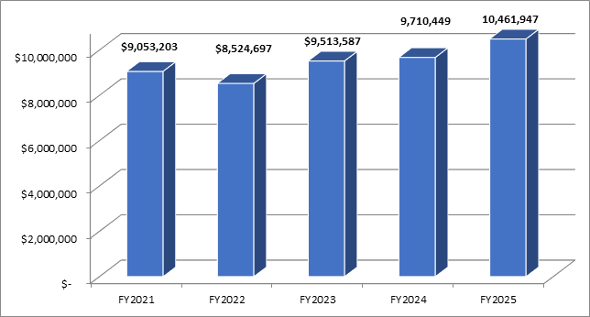
Monomoy Regional School District

Slide 33
Cape Cod Regional Technical High School
Preliminary Assessment for FY2025 is $607,980
Budget will be finalized late January
Increase of 7 Chatham Students (from 13 to 20) -
equates to high percentage increase (60%) in assessment
Await Health Insurance vote and Chapter 70 figures
Notes:
Final Vote in February.

Slide 34
Notes:
CCTHS FY2025 Assessment is directly related to the addition of 7 students (from 13 to 20) next year.

Slide 35
Water Department Budget – Separate Article
TOTAL: $4,399,250 (+12.41% to FY2024)
$ 273,732 – Salaries (Town Staff Offsets)
$2,200,500 – Expenses (including Contract Operations)
$ 329,930 – Indirect Costs (paid to general fund)
$1,595,087 - Debt Service
Notes:
Supported by Water Revenue. Large increase due to increase in debt service for the Water Treatment Plant (Mill Pond Wells).
Need to monitor revenue/rates to be self-supporting.

Slide 36
FY2025 Capital Plan ($10,000 - $250,000)
$10,493,491 in requests for FY2025; $2,367,220 recommended – Using Free Cash in the amount of $2,154,000.
All Capital item requests are included in the 5-Year Plan for an overall financial picture)
5.4% of Operating Budget (not including warrant articles)
Notes:
Items moved to operating; larger items to be presented separately.
Some of the Capital Requests that were not approved for the Capital Plan in 2025 will be moved to the next fiscal year for consideration.

Slide 37
Capital Budget - FY2025
CAPITAL PROGRAM SUMMARY | FY2024 Actual | FY2025 Dept. Request | FY2025 Proposed
General Government | 390,000 | 500,000 | 400,000
Public Safety | 240,000 | 325,000 | 174,720
Community Services |  | 506,291 | 200,000 -
Natural Resources | 395,000 | 1,120,000 | 195,000
Public Works (without Water) | 1,490,000 | 6,226,000 | 660,000
Equipment | 1,159,000 | 1,816,200 | 737,500
Total Town Funded Capital Budget | 3,674,000 | 10,493,491 | 2,367,220
Notes:
Items that fall out of the range will be separate articles
Collins Center – ranking, ‘maintenance’ items s/b in operating

Slide 38
Capital Budget - FY2025
Funding Sources:
Free Cash | $2,154,000
Waterways Improvement Funds | $80,000
Cemetery Sale of Lots | $25,000
PEG Access Fund | $20,000
Prior Articles | $88,220
TOTAL | $2,367,220
Notes:
Funding Sources, no use of tax levy

Slide 39
Capital Review Criteria
Preserve or enhance Town assets
Increase efficiency and effectiveness of government
Fiscal Sustainability - generates revenues, grants
Impact on Savings in the Operating Budget
Impact on Utilization by Public
Influence on local policy areas – (Chatham Factor)
*Aesthetics / Historic Preservation *Cultural and Recreational Opportunities
*Economic Growth *Environmental Sustainability
*Public Health & Safety
Notes:
You have seen this before, use this criteria for Capital articles capital budget

Slide 40
Other Articles – Pending Review
Community Preservation Act Projects (Voted January 22, 2024)
Notes:
Items in the Capital plan are noted where requests to CPC for funding or otherwise.

Slide 41
Other Articles Pending Review
Articles funded through the Tax Levy
Dredging - $400,000
Childcare Voucher Program - $125,000
OPEB Annual Funding - $150,000 (Tax Levy vs Overlay Surplus)
Stabilization – $150,000 Transfer from Overlay Surplus (Per Financial Policies)
Potential Capital Articles:
Transfer Station Roll-off Truck - $361,700
Airport – Capital Improvements -$170,000
Airport Capital – EV Project - $440,657
Other Funding:
Sewer Capital - $1,735,000 Transfer from Wastewater Capital Stabilization Fund - Lining of 8-inch Asbestos-Cement Force Main Pipe, Rehab of Septage Bldg Lakeside, Original Sewer Collection System Repairs
Notes:
These articles will be brought before the Selectboard for discussion/recommendation through February. Airport Capital seeks funding of three (3) capital projects identified by the Airport Commission for implementation to address deficiencies in existing Town owned buildings at the Chatham Municipal Airport. Building projects deemed to be maintenance projects are not eligible for Federal Aviation Administration (FAA) grant funding under their Airport Improvement Program (AIP). The requested $170,000 is the sum of the following projects: installation of a new emergency generator ($130,000), Quonset roof ($13,000) and electrical service ($27,000) repairs
Use of Available Levy, Free cash is programmed.

Slide 42
Potential Borrowing Authorization Articles and Ballot Questions – Pending Review
Transfer Station Borrowing Authorization – Phase I (Priority 2) - $2,000,000 (Discussed on January 16, 2024)
Proposed Wastewater Phase I Continuation for Design & Engineering - $250,000
Proposed Waterfront Bond Projects - (Re)Authorization/Replenish - $10,000,000. Last voted in 2017
Notes:
We’ll present at upcoming SB meetings for discussion

Slide 43
OPEB Funding
Trust Fund Balance - $4,295,505
“Reallocation” of 1.5% Landbank surtax in FY2021 (November tax bill)
FY2023 Revenue = $510,123
FY2024 YTD = $311,098
$150,000 budget ‘placeholder’ for OPEB funding from Tax Levy, as Overlay Funding of $150,000 will be transferred to Stabilization Fund per our policies (Future discussion Item)
Liability is $14,675,790 (6/30/2023)
Notes:
The Town’s Net OPEB liability as of June 30, 2023 is $14,675,790 a decrease of $2,458,551 from 2023 as the Plan’s Fiduciary Position increased (by $1,143,976) and our total OPEB liability decreased by $1,314,271. The 'reallocation' of 1.5% of the landbank surtax raised $510k in revenue in FY2023 for the OPEB Trust fund and is on pace to raise approximately $600k in FY2024.
For FY2025 we are recommending that the $150k from the Overlay Surplus be transferred to the Stabilization Fund, not the OPEB Trust as has been done in the past. This will keep the Town in compliance with our Financial Policies. Stabilization - It shall be the goal of the Town to achieve and maintain a balance in the Stabilization Fund equivalent to between 3% and 5% of the Town’s general fund operating budget, net of debt service.

Slide 44






FY2025 and beyond
Priorities/Policy Issues/Directives – Select Board Goals and Objectives (continued discussion on January 27, 2024). Not presented in any particular order:
Coastal Resiliency, Environmental Preservation, Natural Resources
Drinking Water
Wastewater
Educational Excellence
Housing Initiatives
Diverse Livable Chatham
Sustainable Local Economy
Notes:
SB goals - The Select Board's goal-setting for Fiscal Year 2025/Calendar Year 2024 focused on envisioning Chatham in 2030. Utilizing SMART goals (specific, measurable, achievable, relevant, and time-bound), the Board identified "goal buckets" where the Town can move forward on initiatives that will encompass previous value statements on a variety of levels to move initiatives forward. The final review and vote on these goals will take place on January 27, 2024.

Slide 45
FY2025 Budget & 2024 Annual Town Meeting Calendar

Slide 46
January 23 Town Manager Recommended FY2025 Budgets to Select Board/Finance Committee
January 27 CAL 2024/FY2025 SB Goals and Objectives Review/Vote
Feb. 20 FinCom Preliminary Recommendation to SB
Feb. 27 SB Approved FY2025 Budgets Transmitted to FinCom
March 15 Finance Committee Recommendations on Warrant Articles
March 19 Annual Town Meeting Warrant Closes
May 13 Annual Town Meeting
May 16 Annual Town Election

